Slide 1
Social behavior analysis
Konrad Danielewski
EBBS 2025, Bordeaux

Slide 2



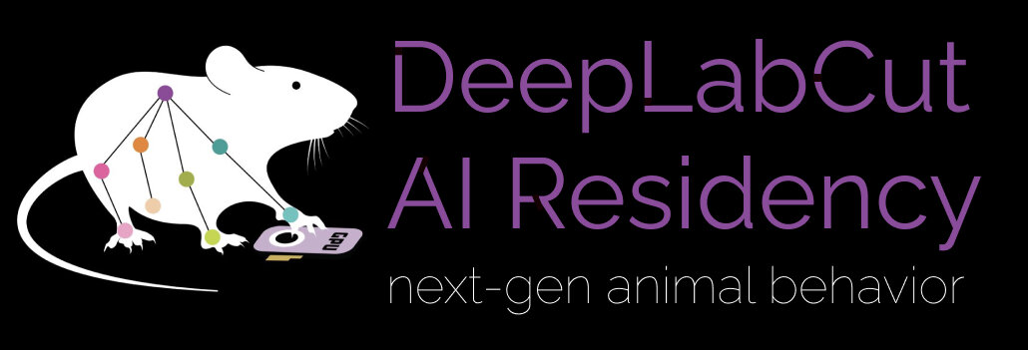
DeepEcoHab
* We’ll get a logo some day

Slide 3
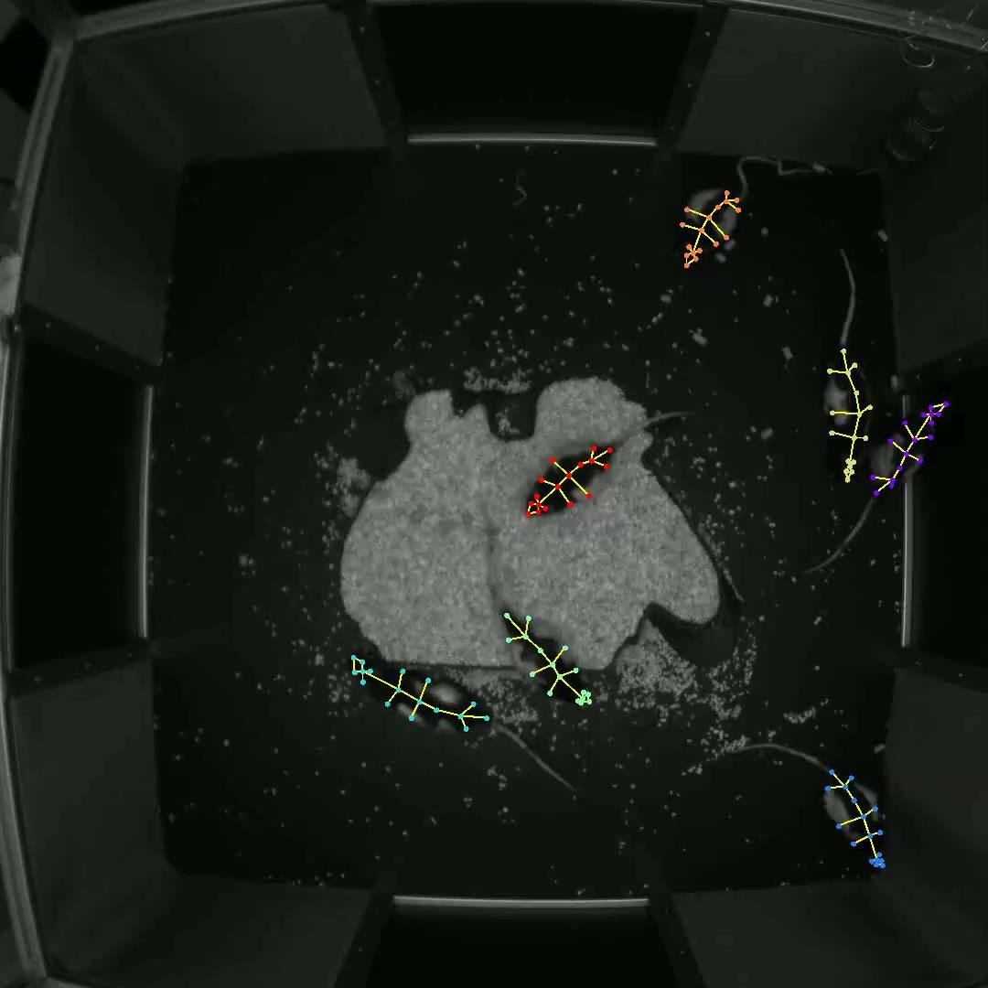

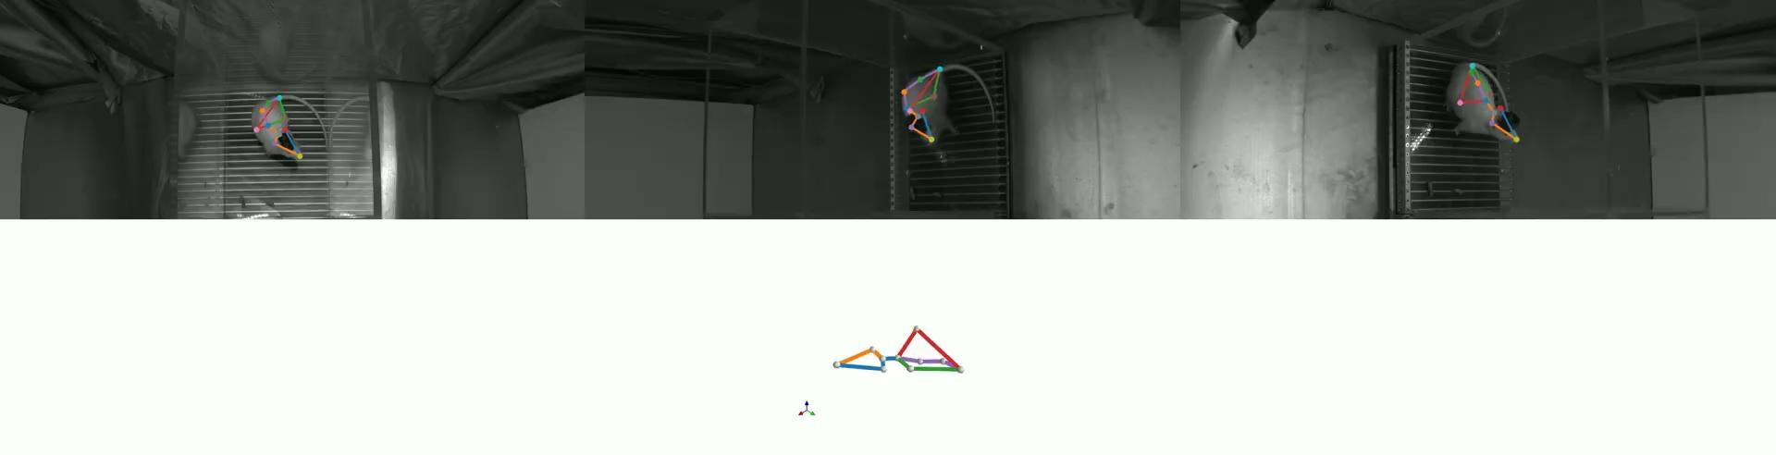

Slide 4
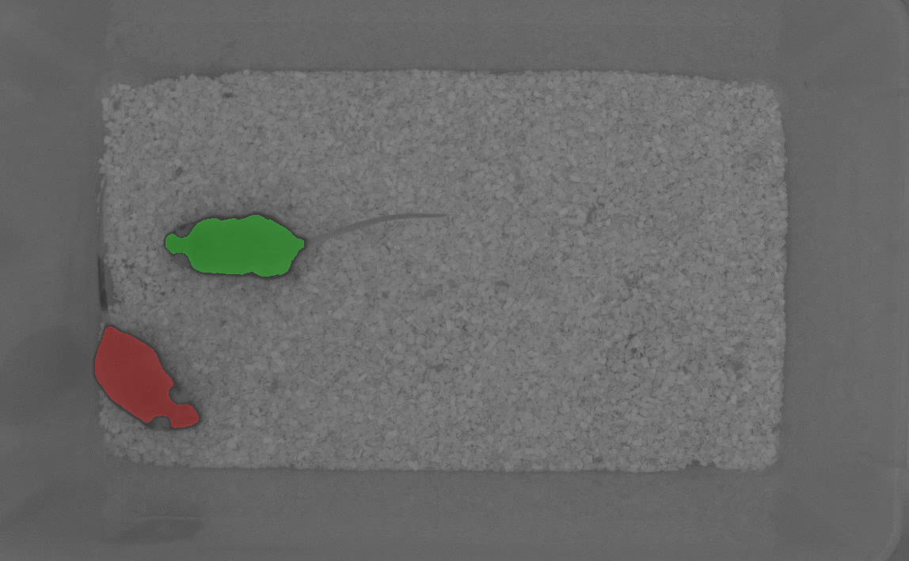
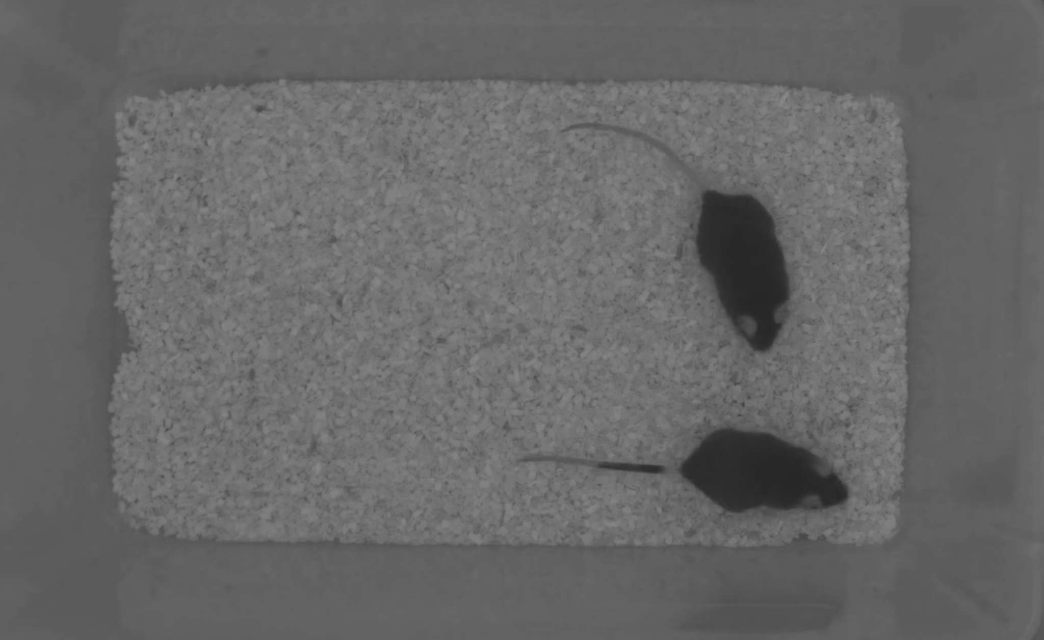
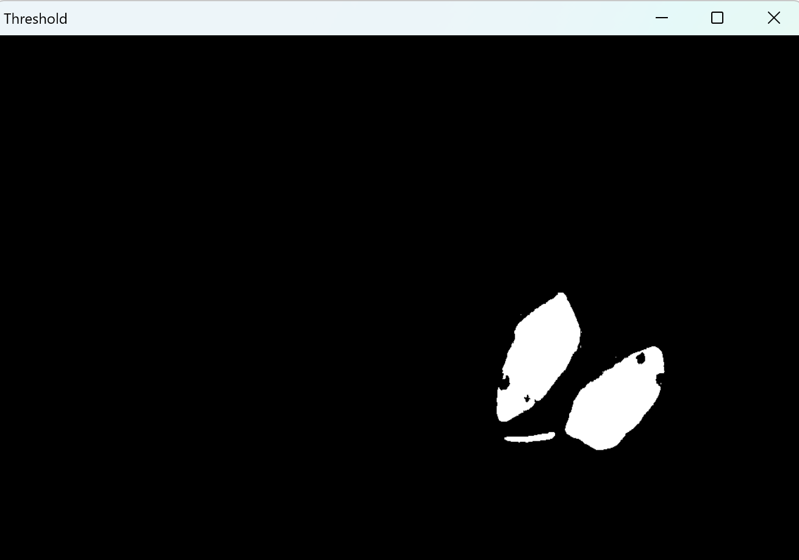
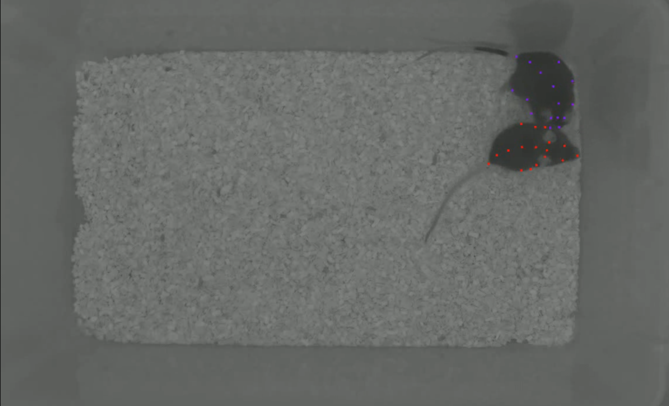
Methods for animal tracking
ind1
ind2
Notes:
Threshold based
background subtraction
image segmentation
pose estimation
object detection

Slide 5
How to choose a method for animal tracking?
Online or offline tracking - do I need it for closed loop experiment?
Data complexity - what is the question I’m trying to answer?
Computational cost - can I use this method efficiently or at all in my use case?
Ability to analyze the data and/or availability of tools

Slide 6
Pros and cons of specific methods
Masks and bounding boxes - high level information (centroids, masks themselves as input to models, rough estimation of interaction)
Pose estimation - lower level information (per keypoint information, kinematics of behavior, good low-dimensional input to models)

Slide 7
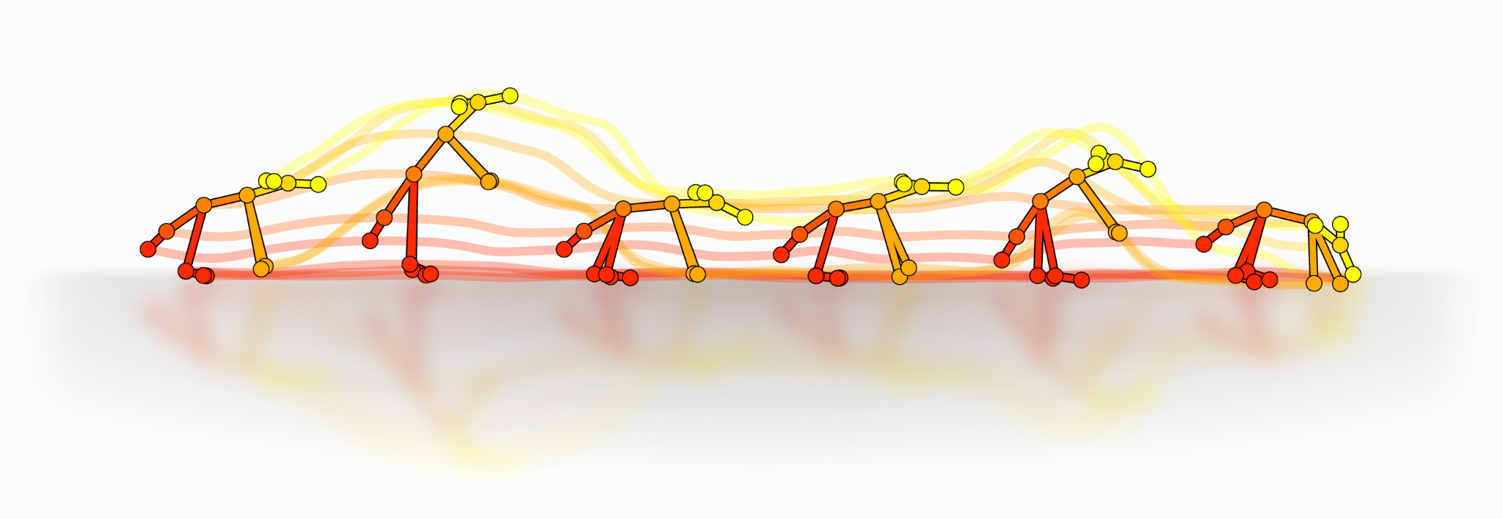

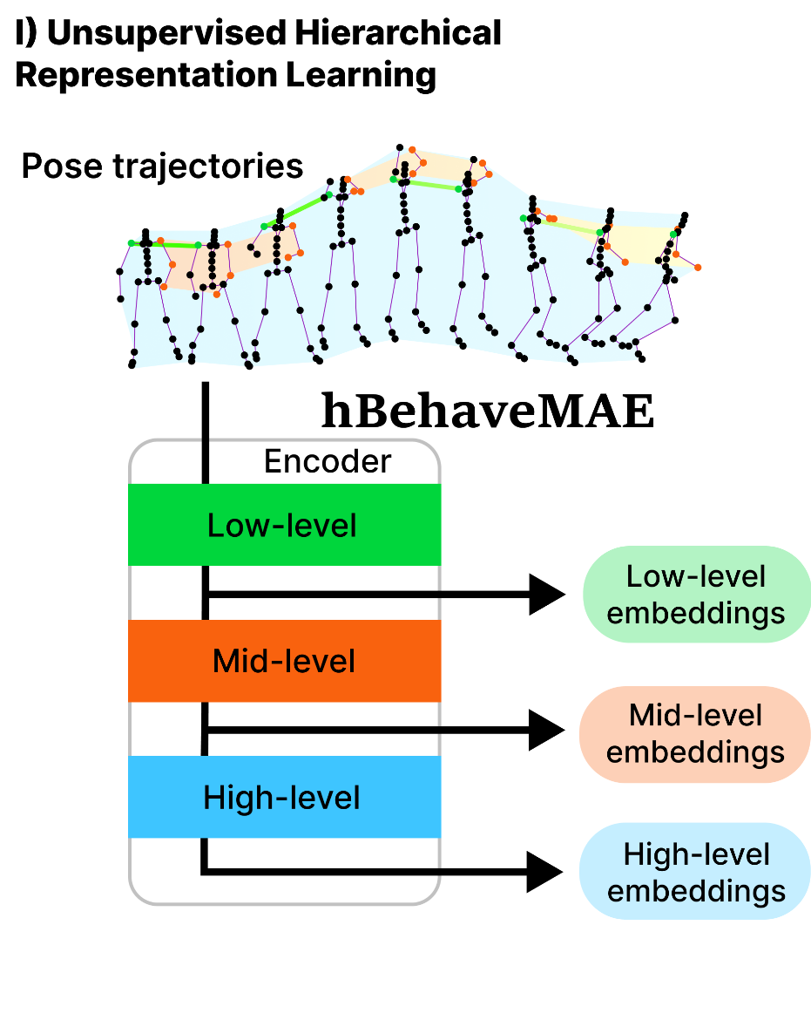

Supervised vs unsupervised
Notes:
What are pros and cons of supervised vs unsupervised
How to choose?

